Slide 1

Sike Ogieva

Slide 2
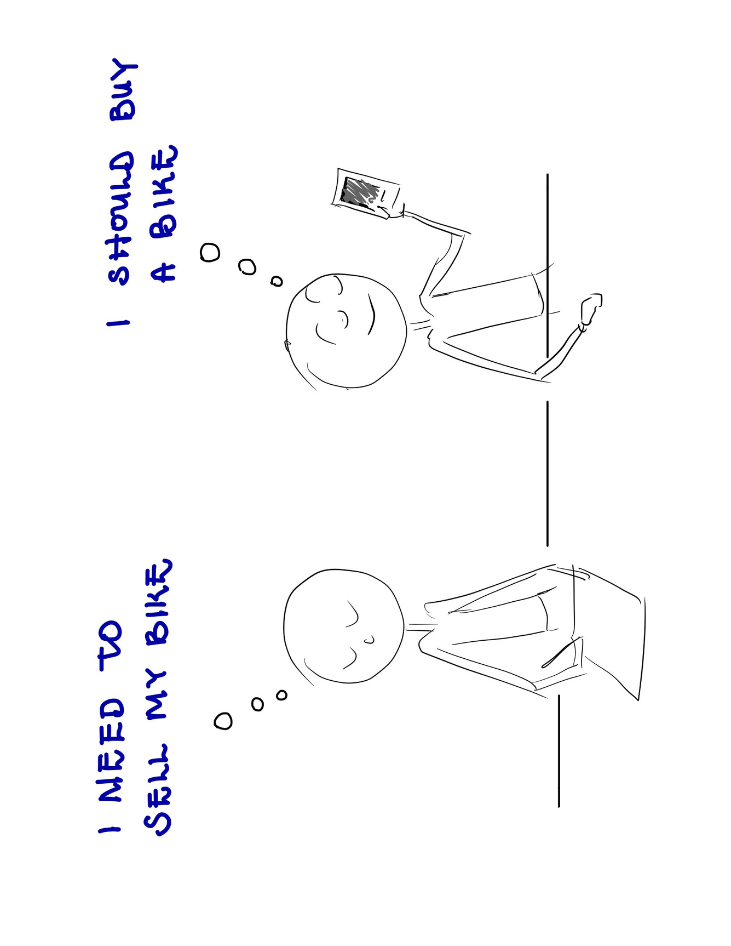

Slide 3
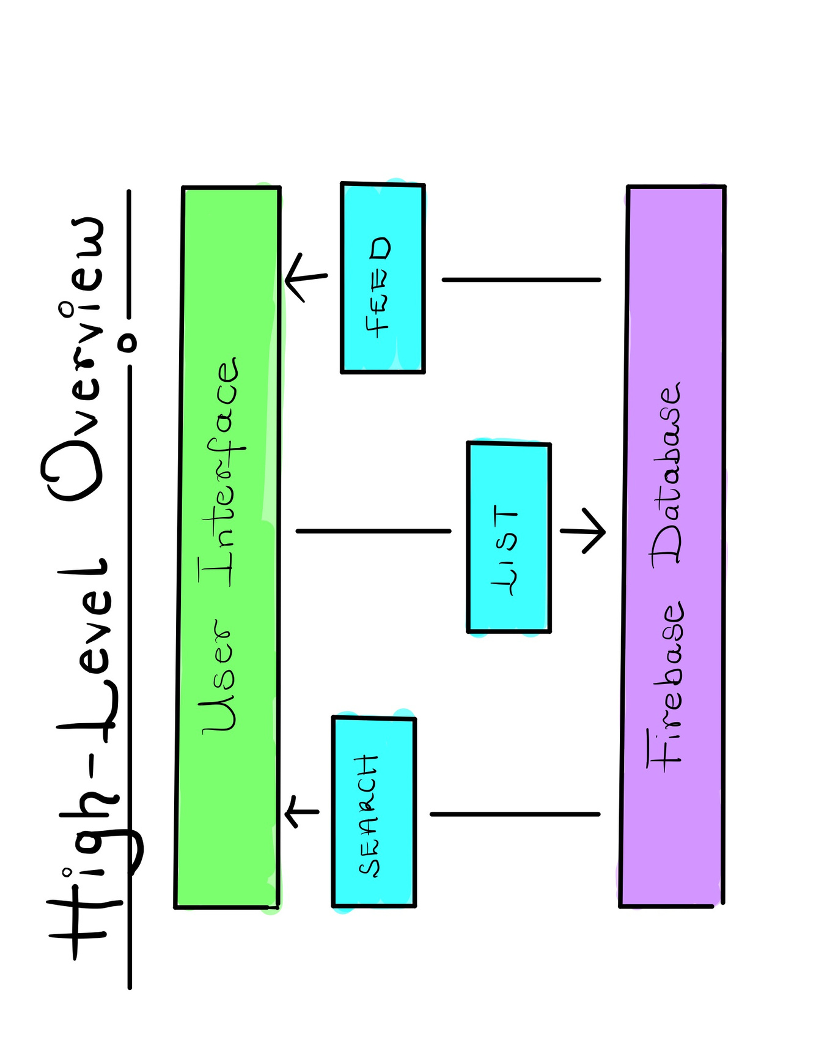

Slide 4


Slide 5
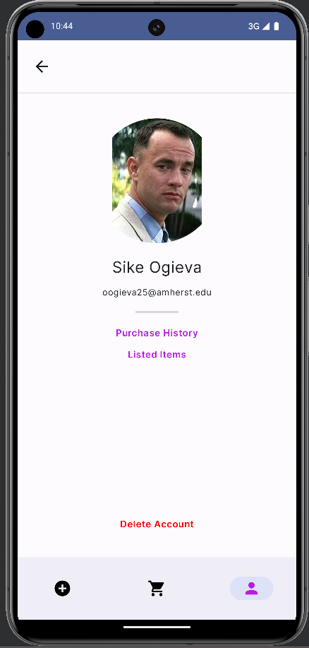
Further Work
edit profile pictures!
see and edit listed items
see purchase history
delete account

Slide 6
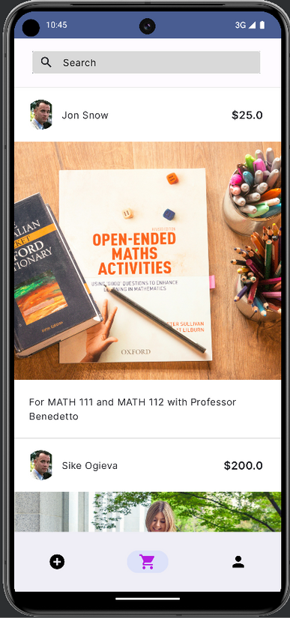
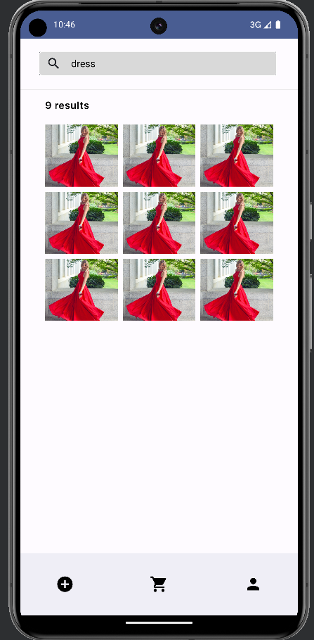


Further Work
User personalized feed
More intelligent
search (e.g. through an API)

